Slide 1
Comic Strip Conversations
An intervention for students with Social and Communication Difficulties

Slide 2
Comic Strip Conversations
(Carol Gray, 1994)
Illustrated interactions that teach conversation skills to students with social and communication difficulties.
A conversation that is supported by simple drawings, symbols and written words, which:
  Identify what people say, focus on what people think.
Can be used to visually “work through” a problem.
Can be used to explore future events.
Teach a social skill.
Convey important information.
Notes:
Devised by Carol Gray in 1994

Slide 3
Rationale
Some students with social and communication difficulties have difficulty identifying the beliefs and motivations of others (Baron-Cohen, 1989).
Comic strip conversations emphasise the importance of thoughts and feelings as well as words and actions.
Helpful in obtaining the perspective of the student, and assist them in communicating their own feelings and ideas.

Slide 4
Symbols
On the following slides are the 8 symbols commonly used within a comic strip conversation including the concepts of everyone talking at once, listening as part of a group, interrupting when someone is still talking, loud words/quiet words, interrupting when 2 people are already talking, talk, listen, and thoughts.
You do not have to use them exactly as drawn here – you can adapt them or make up your own.

Slide 5
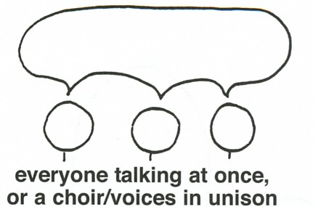
Notes:
The following are the 8 symbols commonly used within a comic strip conversation including the concepts of everyone talking at once, listening as part of a group, interrupt when someone is still talking, loud words/quiet words, interrupt when 2 people are already talking, talk, listen, thoughts.

Slide 6
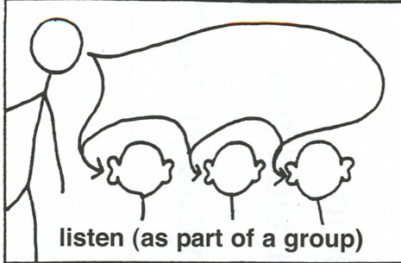

Slide 7
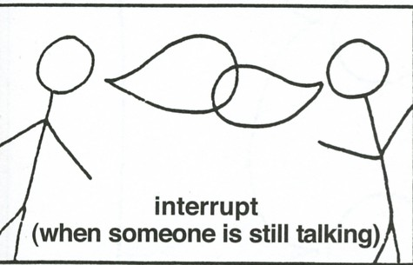

Slide 8
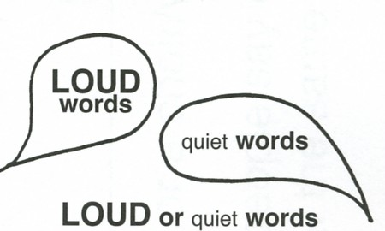

Slide 9
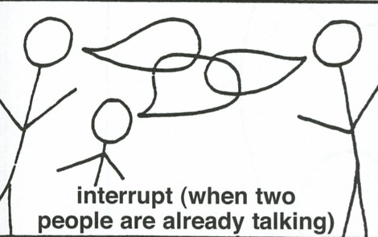

Slide 10
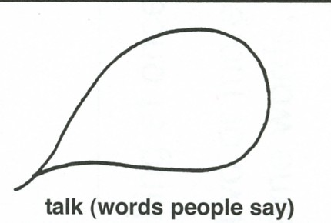

Slide 11
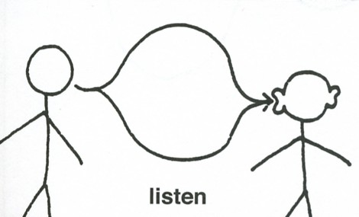

Slide 12
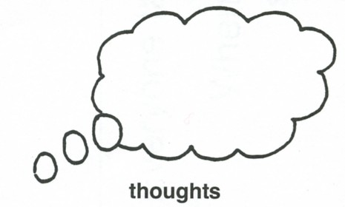

Slide 13
Setting up
Participants are introduced to the idea of drawing while talking.
A selection of drawing and writing materials.
Paper.
Laminate Marker Board/Chalk Board.
Arrange chairs side by side.
Notes:
Paper: Advantages – a permanent record for reference
- can use colour
Disadvantage – cannot erase as part of an ongoing process
White board: Advantages – can erase – both
- can use colour on laminate
Disadvantage – have to erase: cannot get the record of the cartoon strip
Sitting side by side (ideally slightly back ensures that the student leads or guides the conversation, gradually moving towards sharing in a drawn conversation).

Slide 14
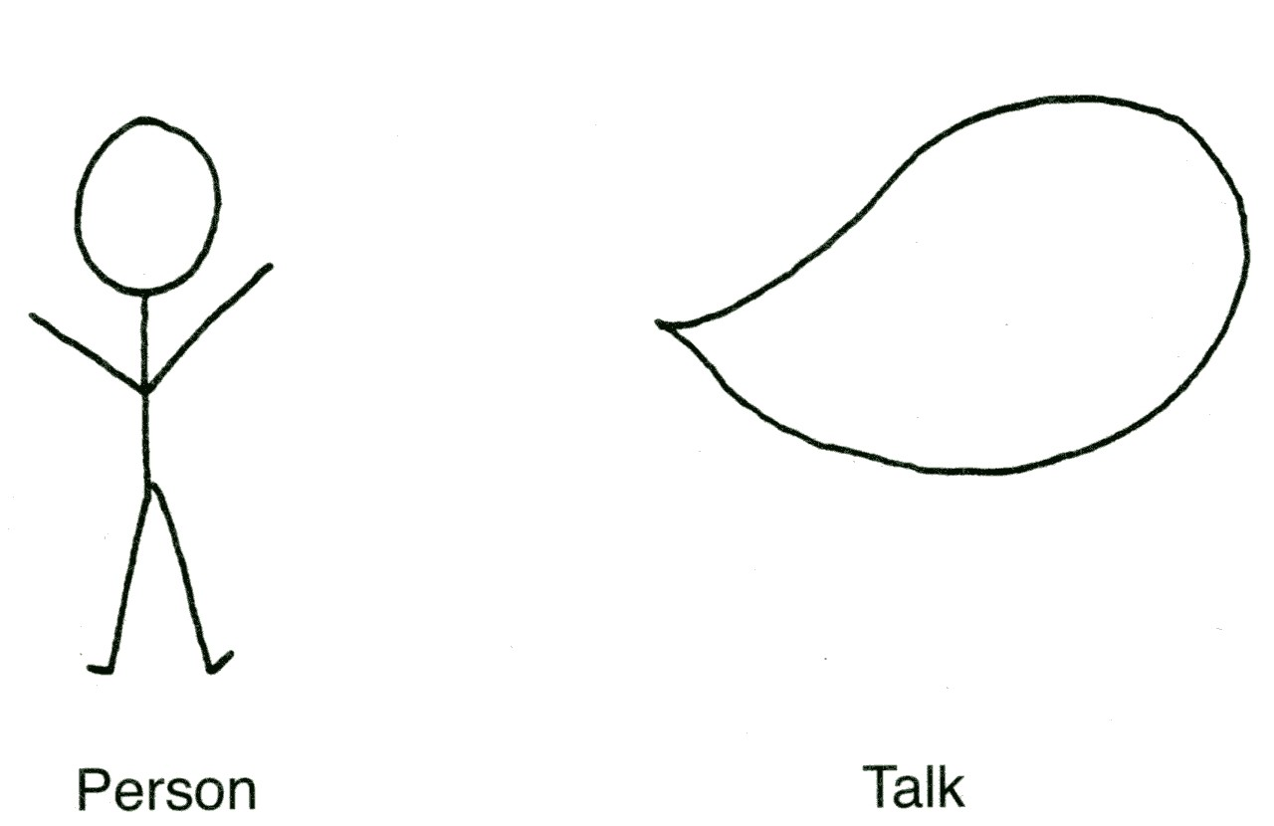
Beginning the conversation
Start with a problem free conversation.
Introduce the first symbols e.g. person and talk.
Use the 8 symbols as they arise.
A Personal Symbols Dictionary.
Notes:
Often the first symbol the pupil learns is person and talk. The student is asked what s/he would like to talk and write about, or an easy topic of interest e.g. trip to Disney.
Icons for Specific people, places, concepts.
Once you have completed a problem free talk, then go on to discussing a problem focused situation.

Slide 15

Where “it” took place
Start with a location symbol e.g. classroom.
ALL the subsequent drawing is focused there until the location sign is changed.

Slide 16
Gathering Information
The adult supports by asking prompt questions:
Where are you? (the student draws a person).
Who else is here? (the student draws a person).
What are you doing? (the student draws relevant items, actions).
What happened? What did others do? (the student draws relevant items, actions).

Slide 17
Gathering Information
5. What did you say? (use talk symbol).
6. What did others say? (use talk symbol).
7. What did you think when you said that? (use thought symbol).
8. What did others think when they said that/did that? (use thought symbol).

Slide 18
Perspectives
Support to think about motives and feelings of others.
Student may volunteer one perspective.
Adult may suggest other alternative perspectives.
Discuss examples.
Notes:
What did the others say?
What did others think when they said that/did that?
If the pupil can’t answer give them an accurate response. For example, the teacher may have said ‘sit down and get on with your maths work. Andrew thinks: I want Andrew to sit in the chair and do maths all day. The answer is accepted as valid but an alternative is provided e.g. I want him to maths first and then play.
Refer to comic strip grid for the structuring grid. This is useful because it helps the student to put the events in order and you can put numbers in the boxes to help. For example ‘what happened first? Lets place number 1 in that box.

Slide 19
Ending the session
Summarise the conversation using the pictures.
Identify solutions: record possible solutions.
Evaluate each solution.
Rank in order of positive outcomes.
Make a plan.
Notes:
Come up with a list of possible solutions relating to the situation. Identify the possible favourite

Slide 20
Using Colour
Introduce colours one at a time as they occur in a conversation.
One idea may trigger conflicting feelings and have more than one colour.
Notes:
The use of colour identifies the emotional content and in many cases the motivation behind a statement, thought or question. Prompt to look at colour chart in notes.

Slide 21
Conversation Colours
Green: good ideas, happy, friendly.
Red: bad ideas, teasing, anger, unfriendly.
Blue: sad, uncomfortable.
Brown: comfortable, cosy.
Purple: proud.
Yellow: frightened.
Black: facts, things we know.
Orange: questions.
Combinations of colours: confused.
Notes:
“Confusion must be sort of like two or more colours at one time. Like red and blue. Or yellow, green, and black. But mostly orange. I think confusion should have orange painted over it.”

